Slide 1
LIFE OF CHRIST

Slide 2
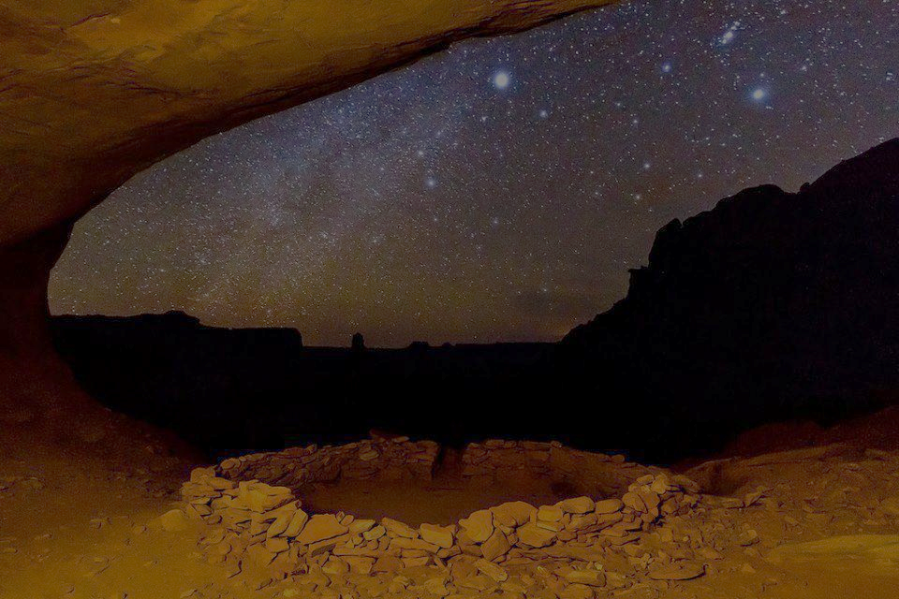
John 18:29 Pilate then went out to them and said, "What accusation do you bring against this Man?" ³⁰ They answered and said to him, "If He were not an evildoer, we would not have delivered Him up to you." ³¹ Then Pilate said to them, "You take Him and judge Him according to your law." Therefore the Jews said to him, "It is not lawful for us to put anyone to death," ³² that the saying of Jesus might be fulfilled which He spoke, signifying by what death He would die.

Slide 3
Jn. 12:32 "And I, if I am lifted up from the earth, will draw all peoples to Myself." ³³ This He said, signifying by what death He would die.
Jn. 3:14 "And as Moses lifted up the serpent in the wilderness, even so must the Son of Man be lifted up, ¹⁵ "that whoever believes in Him should not perish but¹ have eternal life.

Slide 4
Luke 23:1 Then the whole multitude of them arose and led Him to Pilate. ² And they began to accuse Him, saying, "We found this fellow perverting the¹ nation, and forbidding to pay taxes to Caesar, saying that He Himself is Christ, a King." ³ Then Pilate asked Him, saying, "Are You the King of the Jews?" He answered him and said, "It is as you say." ⁴ So Pilate said to the chief priests and the crowd, "I find no fault in this Man." ⁵ But they were the more fierce, saying, "He stirs up the people, teaching throughout all Judea, beginning from Galilee to this place."

Slide 5
Lk. 23:6 When Pilate heard of Galilee, he asked if the Man were a Galilean. ⁷ And as soon as he knew that He belonged to Herod's jurisdiction, he sent Him to Herod, who was also in Jerusalem at that time. ⁸ Now when Herod saw Jesus, he was exceedingly glad; for he had desired for a long time to see Him, because he had heard many things about Him, and he hoped to see some miracle done by Him.

Slide 6
Lk. 9:7 Now Herod the tetrarch heard of all that was done by Him; and he was perplexed, because it was said by some that John had risen from the dead, ⁸ and by some that Elijah had appeared, and by others that one of the old prophets had risen again. ⁹ Herod said, "John I have beheaded, but who is this of whom I hear such things?" So he sought to see Him.

Slide 7
⁹ Then he questioned Him with many words, but He answered him nothing. ¹⁰ And the chief priests and scribes stood and vehemently accused Him.

Slide 8
Proverbs 26:4 Do not answer a fool according to his folly, Lest you also be like him.

Slide 9
11 Then Herod, with his men of war, treated Him with contempt and mocked Him, arrayed Him in a gorgeous robe, and sent Him back to Pilate. 12 That very day Pilate and Herod became friends with each other, for previously they had been at enmity with each other.

Slide 10
Luke 13:1 There were present at that season some who told Him about the Galileans whose blood Pilate had mingled with their sacrifices.

Slide 11
John 18:33 Then Pilate entered the Praetorium again, called Jesus, and said to Him, "Are You the King of the Jews?" 34 Jesus answered him, "Are you speaking for yourself about this, or did others tell you this concerning Me?" 35 Pilate answered, "Am I a Jew? Your own nation and the chief priests have delivered You to me. What have You done?" 36 Jesus answered, "My kingdom is not of this world. If My kingdom were of this world, My servants would fight, so that I should not be delivered to the Jews; but now My kingdom is not from here."

Slide 12
37 Pilate therefore said to Him, "Are You a king then?" Jesus answered, "You say rightly that I am a king. For this cause I was born, and for this cause I have come into the world, that I should bear witness to the truth. Everyone who is of the truth hears My voice."

Slide 13
John 18:38 Pilate said to Him, "What is truth?" And when he had said this, he went out again to the Jews, and said to them, "I find no fault in Him at all. ³⁹ " But you have a custom that I should release someone to you at the Passover. Do you therefore want me to release to you the King of the Jews?" ⁴⁰ Then they all cried again, saying, "Not this Man, but Barabbas!" Now Barabbas was a robber.

Slide 14
Proof for this comes from the other Gospel accounts, which state that this custom of releasing a prisoner occurs on the feast (Mt. 27:15; Mk: 15:6; Lk. 23:17).

Slide 15
Matt. 27:15 Now at the feast the governor was accustomed to releasing to the multitude one prisoner whom they wished. ¹⁶ And at that time they had a notorious prisoner called Barabbas¹. ¹⁷ Therefore, when they had gathered together, Pilate said to them, "Whom do you want me to release to you? Barabbas, or Jesus who is called Christ?" ¹⁸ For he knew that they had handed Him over because of envy. ¹⁹ While he was sitting on the judgment seat, his wife sent to him, saying, "Have nothing to do with that just Man, for I have suffered many things today in a dream because of Him."

Slide 16
²⁰ But the chief priests and elders persuaded the multitudes that they should ask for Barabbas and destroy Jesus. ²¹ The governor answered and said to them, "Which of the two do you want me to release to you?" They said, "Barabbas!" ²² Pilate said to them, "What then shall I do with Jesus who is called Christ?" They all said to him, "Let Him be crucified!" ²³ Then the governor said, "Why, what evil has He done?" But they cried out all the more, saying, "Let Him be crucified!"

Slide 17
²⁴ When Pilate saw that he could not prevail at all, but rather that a tumult was rising, he took water and washed his hands before the multitude, saying, "I am innocent of the blood of this just Person. You see to it." ²⁵ And all the people answered and said, "His blood be on us and on our children." ²⁶ Then he released Barabbas to them; and when he had scourged Jesus, he delivered Him to be crucified. ²⁷ Then the soldiers of the governor took Jesus into the Praetorium and gathered the whole garrison around Him. ²⁸ And they stripped Him and put a scarlet robe on Him.

Slide 18
²⁹ When they had twisted a crown of thorns, they put it on His head, and a reed in His right hand. And they bowed the knee before Him and mocked Him, saying, "Hail, King of the Jews!" ³⁰ Then they spat on Him, and took the reed and struck Him on the head. ³¹ And when they had mocked Him, they took the robe off Him, put His own clothes on Him, and led Him away to be crucified.

Slide 19
John 19:1 So then Pilate took Jesus and scourged Him.

Slide 20
The scourge was a whip with several thongs, each loaded with acorn-shaped balls of lead, with sharp pieces of bone or spikes. Stripped of His clothes, His hands tied by a lictor, who plied these instruments of torture with severity almost to the point of the death of the prisoner. Each stroke cut into the quivering flesh, until the veins and sometimes the entrails were laid bare. Often the scourge struck the face and knocked out the eyes and teeth. Scourging almost always ended in fainting and sometimes even in death (H. I. Hester, The Heart of the New Testament (Liberty, Missouri: The William Jewell Press, 1962), p. 213.).

Slide 21
The scourge was made of rods or throngs with pieces of bone or lead fastened to one end. The condemned person received the blows while fastened to a post so as to have the back bent and the skin stretched. With the blows the back became raw and the blood spurted out. The punishment was so cruel that the condemned person very often succumbed to it immediately. (David Lipscomb, A Commentary on the Gospel by John (Nashville, Tennessee: Gospel Advocate Company, 1966).

Slide 22
John 19:2 And the soldiers twisted a crown of thorns and put it on His head, and they put on Him a purple robe. ³ Then they said, "Hail, King of the Jews!" And they struck Him with their hands.
We are given more details about this event in Matthew 27:27-31 and Mark 15:16-20.

Slide 23
John 19:4 Pilate then went out again, and said to them, "Behold, I am bringing Him out to you, that you may know that I find no fault in Him." ⁵ Then Jesus came out, wearing the crown of thorns and the purple robe. And Pilatesaid to them, "Behold the Man!"

Slide 24
John 19:6 Therefore, when the chief priests and officers saw Him, they cried out, saying, "Crucify Him, crucify Him!" Pilate said to them, "You take Him and crucify Him, for I find no fault in Him." ⁷ The Jews answered him, "We have a law, and according to our law He ought to die, because He made Himself the Son of God."

Slide 25
They wanted Him dead because “He made Himself the Son of God” (Mk. 14:62; Jn. 5:18; 10:30-33).

Slide 26
Leviticus 24:16 'And whoever blasphemes the name of the LORD shall surely be put to death. All the congregation shall certainly stone him, the stranger as well as him who is born in the land. When he blasphemes the name of the Lord, he shall be put to death.

Slide 27
John 19:8 Therefore, when Pilate heard that saying, he was the more afraid, ⁹ and went again into the Praetorium, and said to Jesus, "Where are You from?" But Jesus gave him no answer. ¹⁰ Then Pilate said to Him, "Are You not speaking to me? Do You not know that I have power to crucify You, and power to release You?" ¹¹ Jesus answered, "You could have no power at all against Me unless it had been given you from above. Therefore the one who delivered Me to you has the greater sin."

Slide 28
This same principle is taught throughout the Bible (Job 12:23; Dan. 5:17-28; Rom. 13:1).

Slide 29
We are not given many details about this, but Jesus also implies various degrees of punishment in hell:
It will be more tolerable for Tyre, Sidon, and Sodom (Mt. 11:20-24; 10:15).
The one who knows the master’s will will be beaten with many stripes (Lk. 12:42-48).
Those who trample on the Son of God deserve a worse punishment (Heb. 10:26-31).
Those who know the truth and turn from it, their sinful state will be worse (2 Pet. 2:20-22).
Those who teach will be judged with a stricter judgment (Jam. 3:1).

Slide 30
John 19:12 From then on Pilate sought to release Him, but the Jews cried out, saying, "If you let this Man go, you are not Caesar's friend. Whoever makes himself a king speaks against Caesar." ¹³ When Pilate therefore heard that saying, he brought Jesus out and sat down in the judgment seat in a place that is called The Pavement, but in Hebrew, Gabbatha.

Slide 31
Matthew 27:24 When Pilate saw that he could not prevail at all, but rather that a tumult was rising, he took water and washed his hands before the multitude, saying, "I am innocent of the blood of this just Person. You see to it."

Slide 32
John 19:14 Now it was the Preparation Day of the Passover, and about the sixth hour. And he said to the Jews, "Behold your King!" ¹⁵ But they cried out, "Away with Him, away with Him! Crucify Him!" Pilate said to them, "Shall I crucify your King?" The chief priests answered, "We have no king but Caesar!" ¹⁶ Then he delivered Him to them to be crucified. So they took Jesus and led Him away.

Slide 33
The `preparation day' was the day preceding the beginning of the seven days' feast of unleavened bread Friday. `Passover' signifies the entire period of the feast, the first day of which was the sabbath (John 19:31,42; Mark 15:42; Matt. 27:62; Luke 23:54). The `sixth hour' was 6 a.m., according to Roman reckoning which John followed, and is in complete harmony with Mark's statement (Mark 15:25), that Jesus was crucified at the third hour, by Jewish computation (which Mark followed), was 9 a.m.

Slide 34
Under Roman law, sentence could not be pronounced earlier than 6 a.m.; it is probable than an hour or so elapsed before the court proceedings were completed and Jesus was delivered up to be crucified. The painful trip to Calvary was to occur before the crucifixion would begin (Guy N. Woods, A Commentary on the Gospel according to John (Nashville, Tennessee: Gospel Advocate Company, 1981), p. 397-398).

Slide 35
John 19:14 Now it was the Preparation Day of the Passover, and about the sixth hour. And he said to the Jews, "Behold your King!" ¹⁵ But they cried out, "Away with Him, away with Him! Crucify Him!" Pilate said to them, "Shall I crucify your King?" The chief priests answered, "We have no king but Caesar!"

